Slide 1


Slide 2
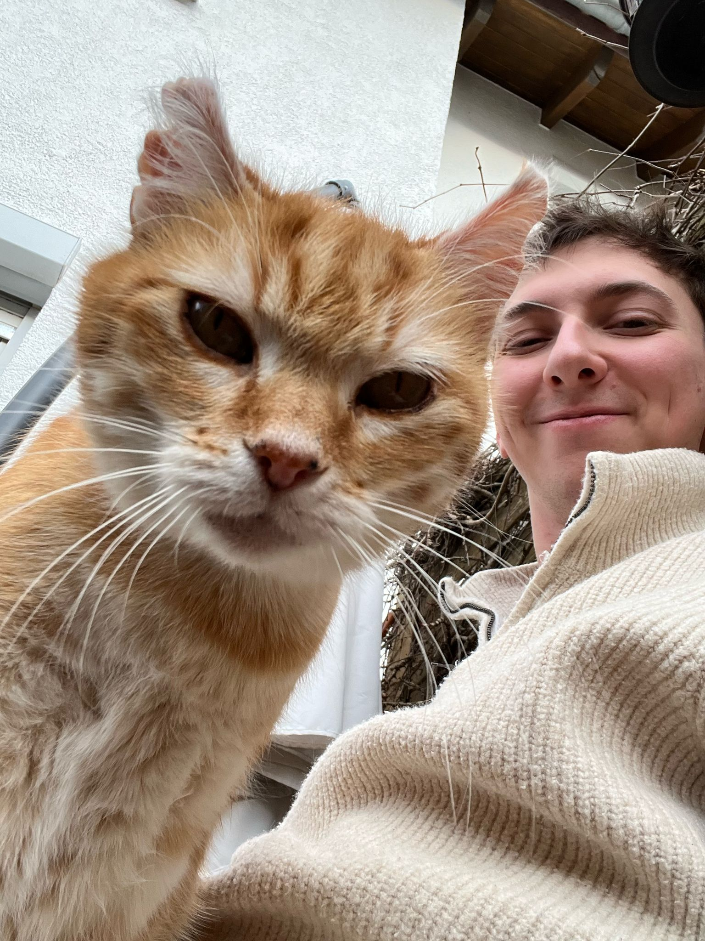


Background
Jonas Scholz, Co-Founder @
Cloud Infrastructure Nerd
Docker Captain
Not a cat
Jonas Scholz

Slide 3
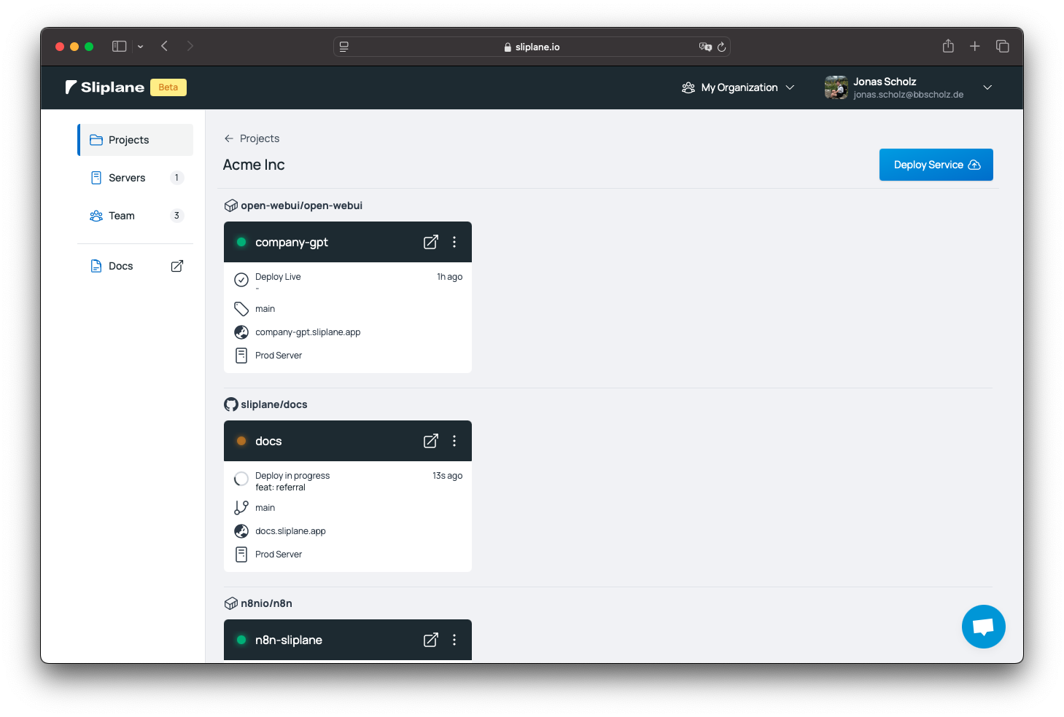
Background
European Platform-as-a-Service
Building the easiest way to deploy Docker container
git push ↣ deploy
Free Trial + Easy Platform attracts abuse!
Jonas Scholz

Slide 4
Abuse
Crypto Mining
Illegal VPNs
Netscans
DDoS
Spambots
Phishing
Jonas Scholz

Slide 5
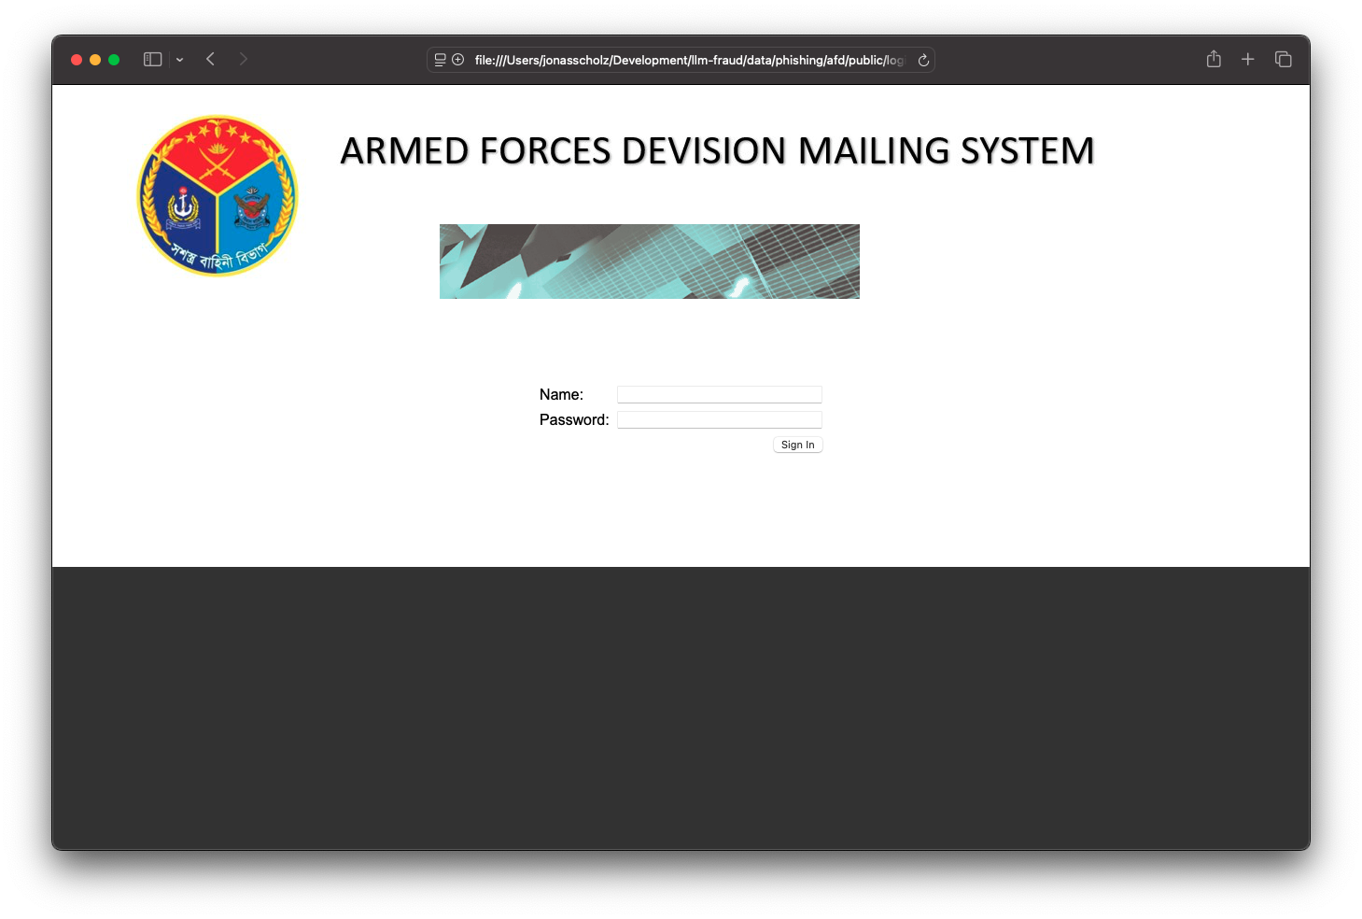
Phishing
Jonas Scholz

Slide 6
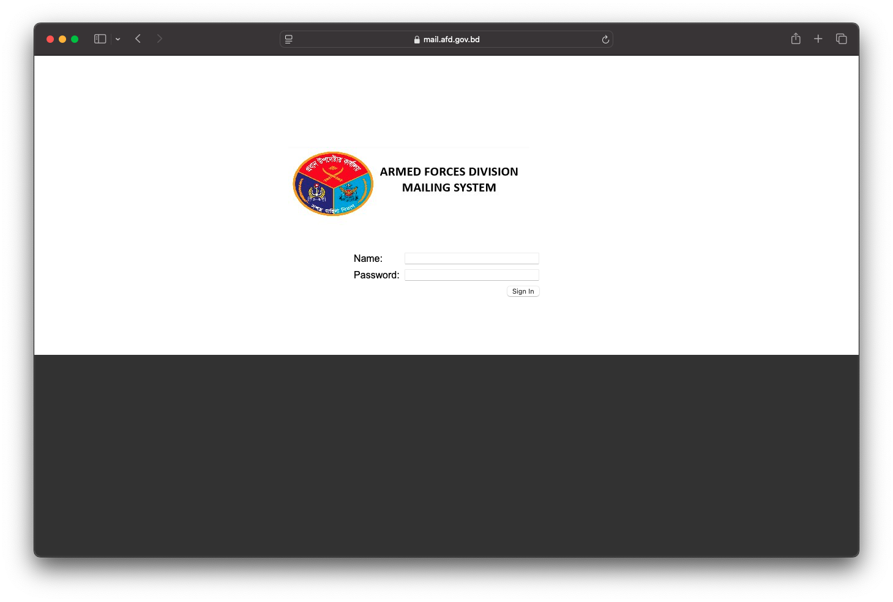
Phishing
Jonas Scholz

Slide 7
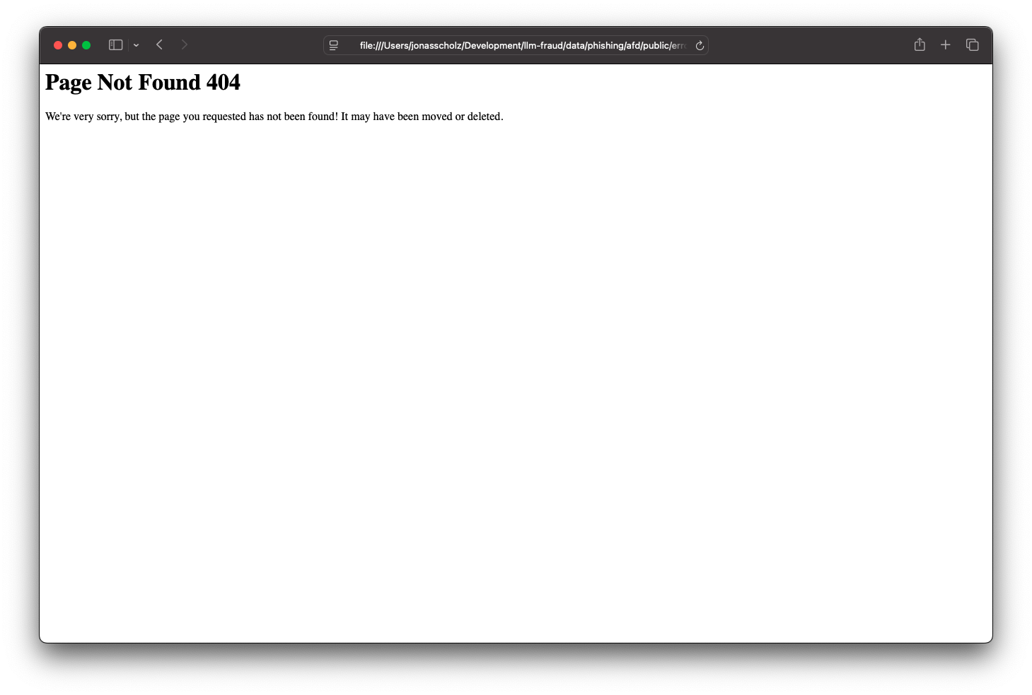
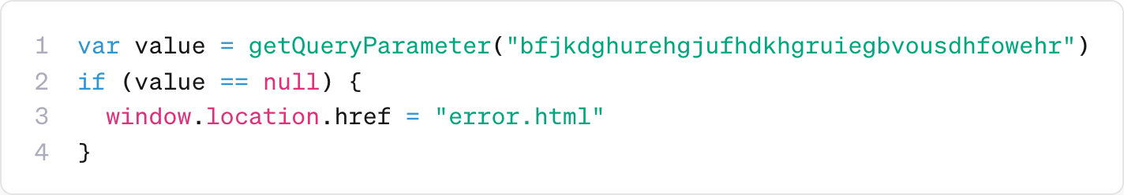
Problem
Obfuscated
Hard to detect (looks normal)
Sheer volume
Jonas Scholz

Slide 8
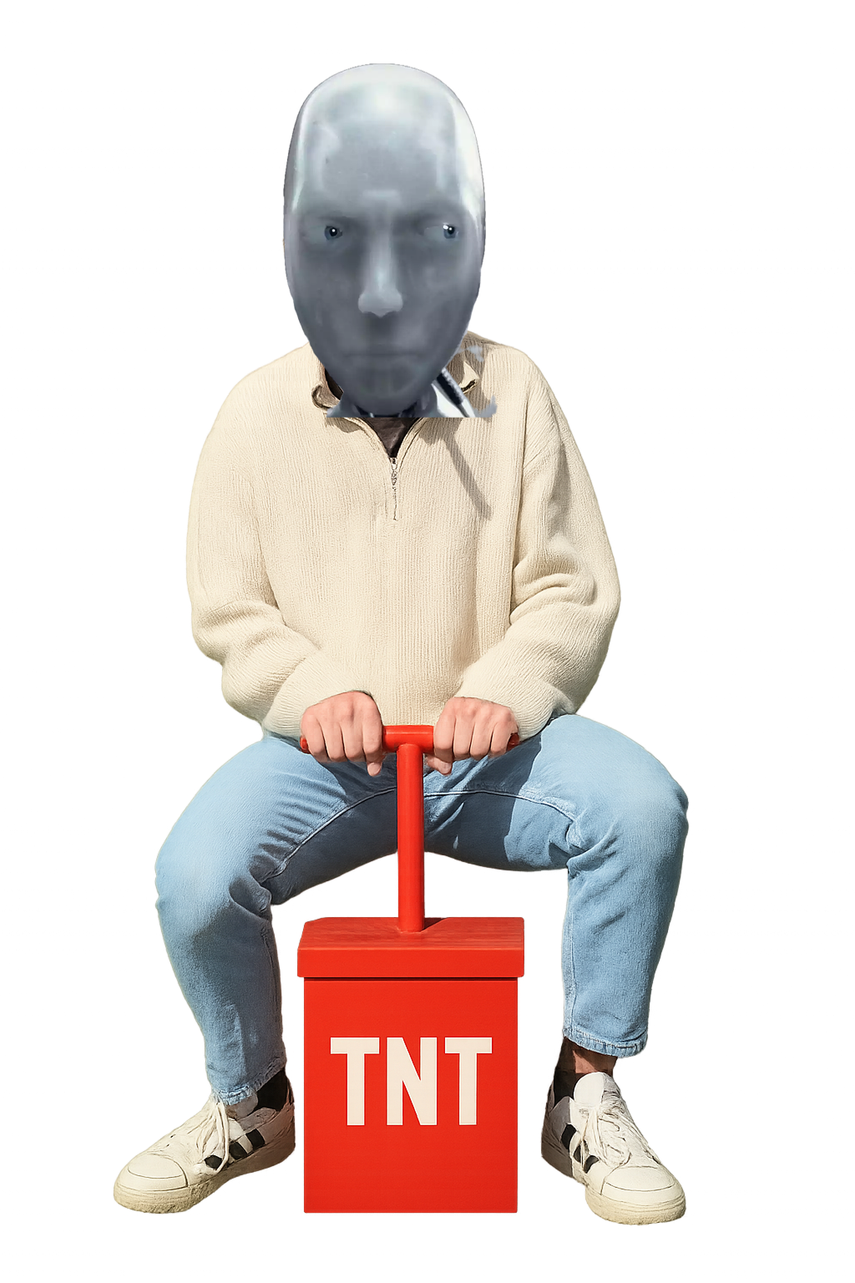


Solution
Replace me with an army of context-aware agents!
Jonas Scholz

Slide 9
Architecture
Ignore
Not sketchy
User Triggers Deploy
Sketchy Prefilter
Agent
Human-in-the-loop
Maybe sketchy
Sends result to
git push
Statistical prefiltering
Evaluate Codebase
Final Decision
Deploy
Jonas Scholz

Slide 10

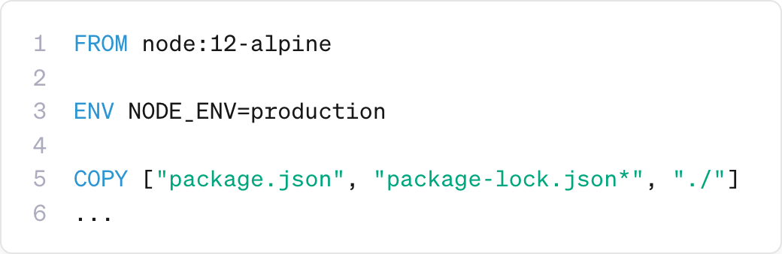
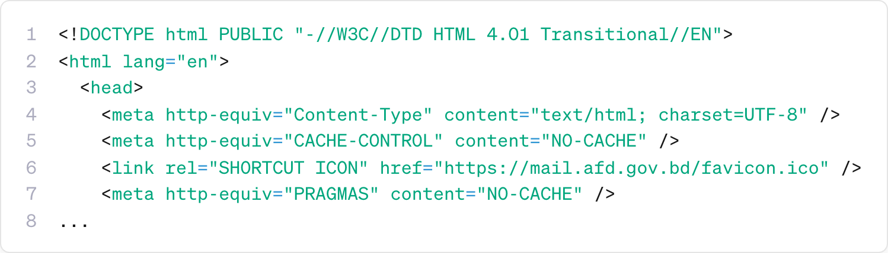
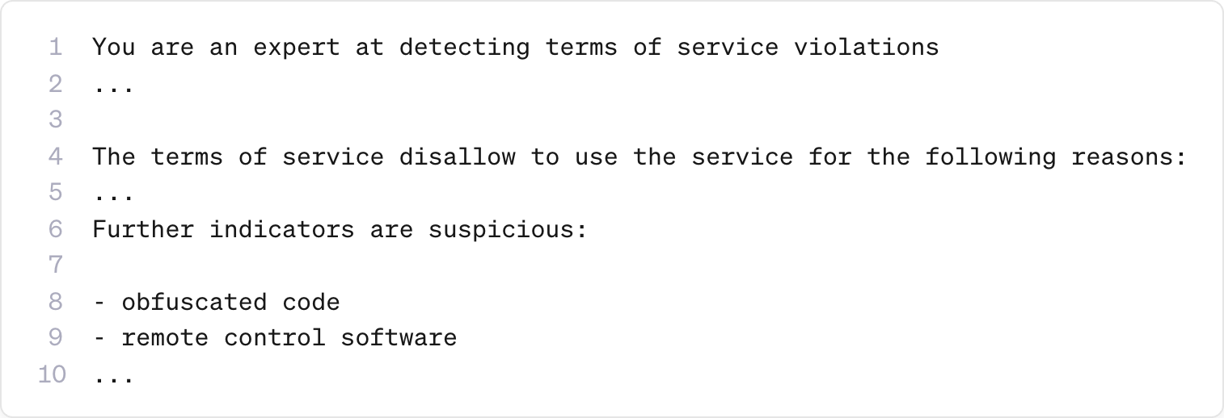
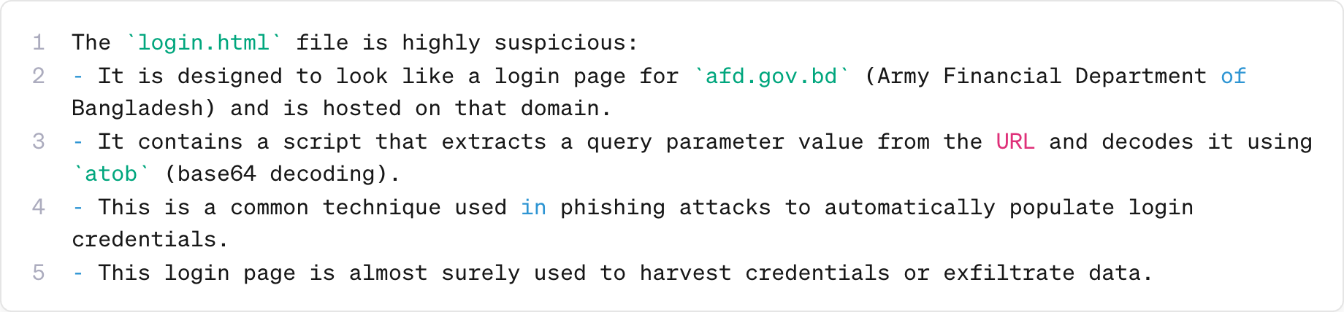
Agent
All models are open-source, self-hosted and with 0 data retention!
Dockerfile
in-memory git clone
requirements.txt
+
src
main.py
login.html
Classification
Context Compacting
retries
Jonas Scholz

Slide 11
Agent
All models are open-source, self-hosted and with 0 data retention!
Jonas Scholz

Slide 12


Summary
Be unattractive enough for abuse
Red teaming is necessary!
Small models are still years behind
Checkout sliplane.io for deploying container!
Connect with me on LinkedIn:
https://www.linkedin.com/in/jonas-scholz-490274163/
Jonas Scholz

